Slide 1
Python week 9
Canberra Chinese School Sem1

Slide 2

Review (Variables)
Data Types & Variables:
Strings (text), Integers (whole numbers), Floats (decimals), Booleans (True/False).
Type conversion (e.g., int(), str())
User input with input()
Lists

Slide 3
Review (lists)
Lists:
0-based indexing: first item is list[0].
Access/modify elements: names[n].
Operations: append, remove, etc.
Lists can store mixed types.

Slide 4
Review (Loops)
For loops: for x in range(n):
— repeats code a fixed number of times.
While loops: while condition:
— repeats as long as the condition is True.
Indentation (tab) is important.

Slide 5
Review (If statements)
if condition:
— Executes code if condition is true
if, elif, else.
Comparison operators: ==, !=, >, <, >=, <=.
Logical operators: and, or

Slide 6
Review (Random)
import random
random.randint(a, b) — random integer in range (inclusive).
random.choice(list) — pick random item from a list.
Useful for games (dice, coin flips).

Slide 7
Review (Functions)
def function_name(): — reusable blocks of code.
Calling functions: function_name().

Slide 8
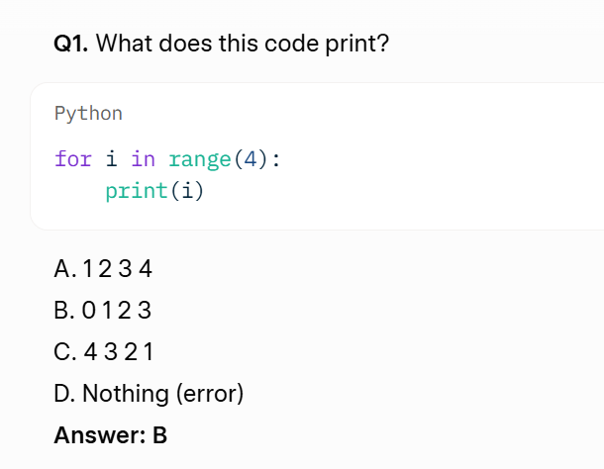
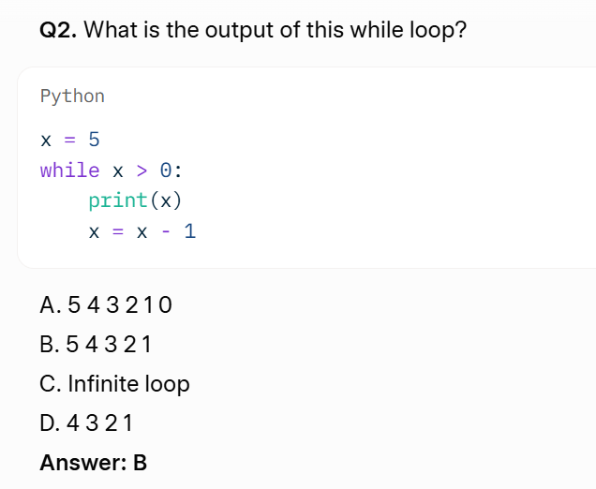
Quizzes

Slide 9
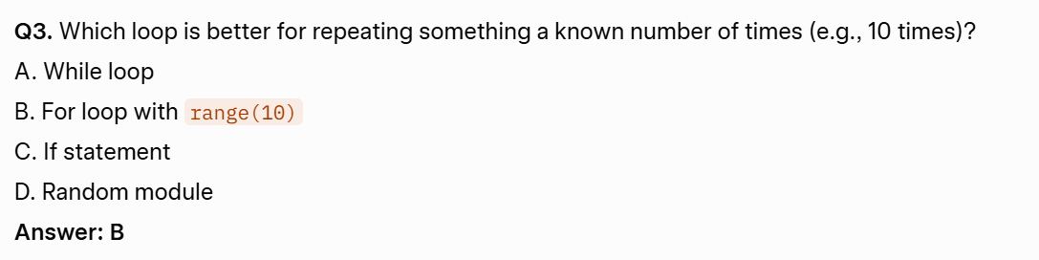
Quizzes

Slide 10
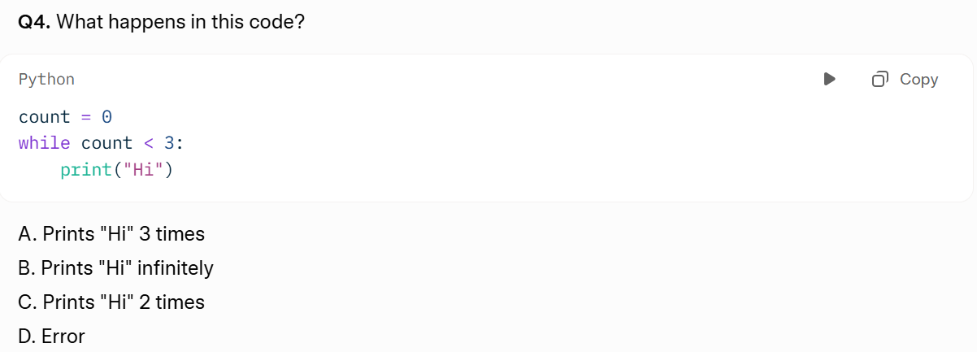
Quizzes
Answer: B

Slide 11
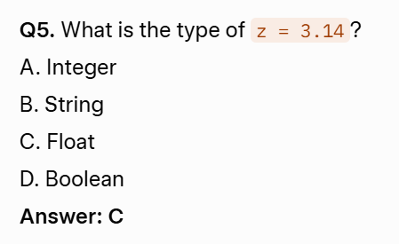
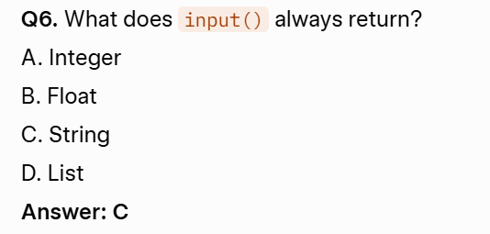
Quizzes (A lot more ahead)

Slide 12
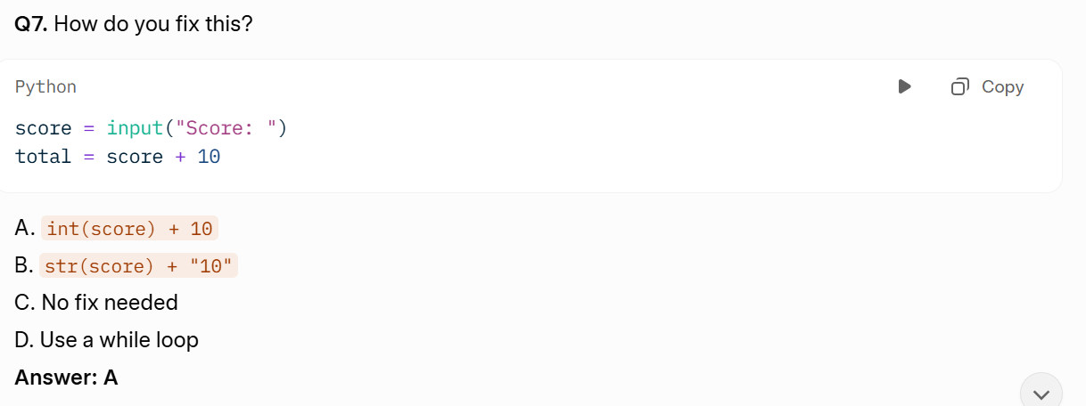
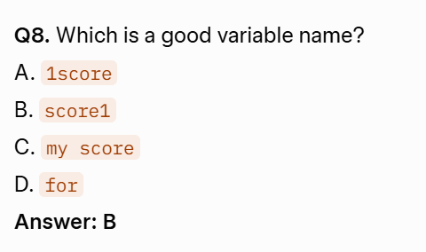
Quizzes

Slide 13
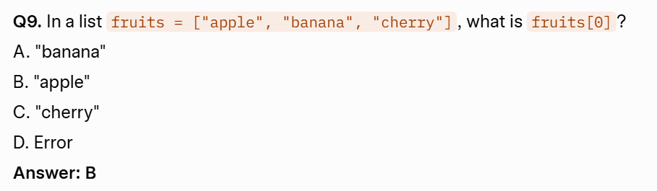
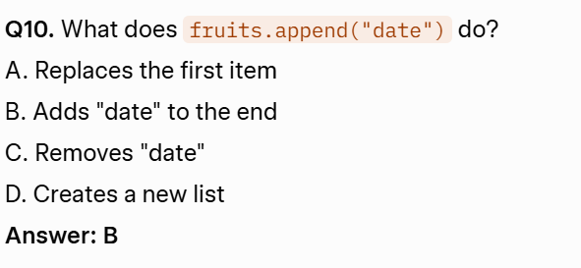
Quizzes

Slide 14
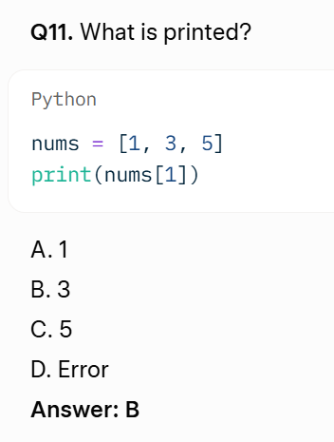
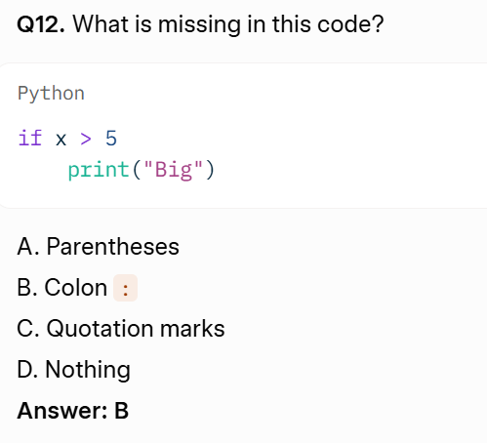
Quizzes (2 more slides)

Slide 15
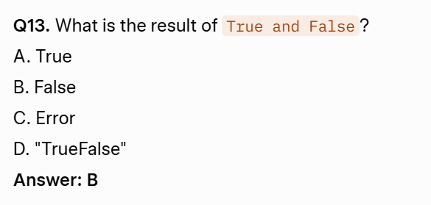
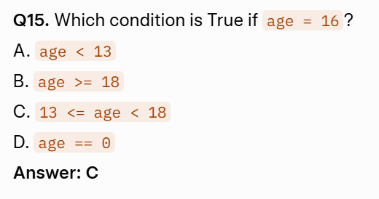
Quizzes (1 more slide)

Slide 16
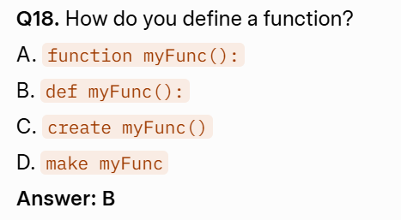
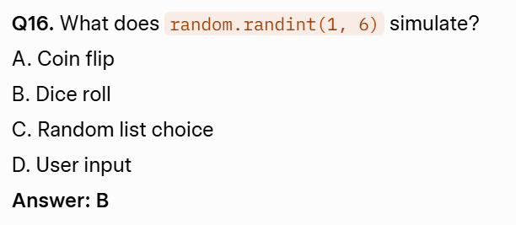
Quizzes (last slide for quizzes)

